Slide 1
ANALYSIS ON COVID19 Tweets: Tweets with the hashtag #covid19
ANALYSIS:COVID19 Tweets
NAME :AYOSHARYA DAS

Slide 2
INTRODUCTION
We are going to analyze on covid19 Tweets dataset. This covid19 tweets dataset having information of all tweets based on covid19#tag made by different location people during this pandemic situation. The
data collection started on 25/7/2020.From this dataset we will be able to analyze the situation and views of different location people. After recognizing the situation we can take a proper solution to prevent covid19.

Slide 3
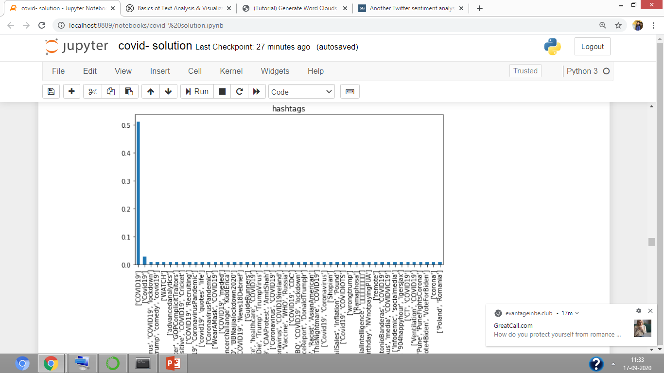
Hashtags GRAPH

Slide 4
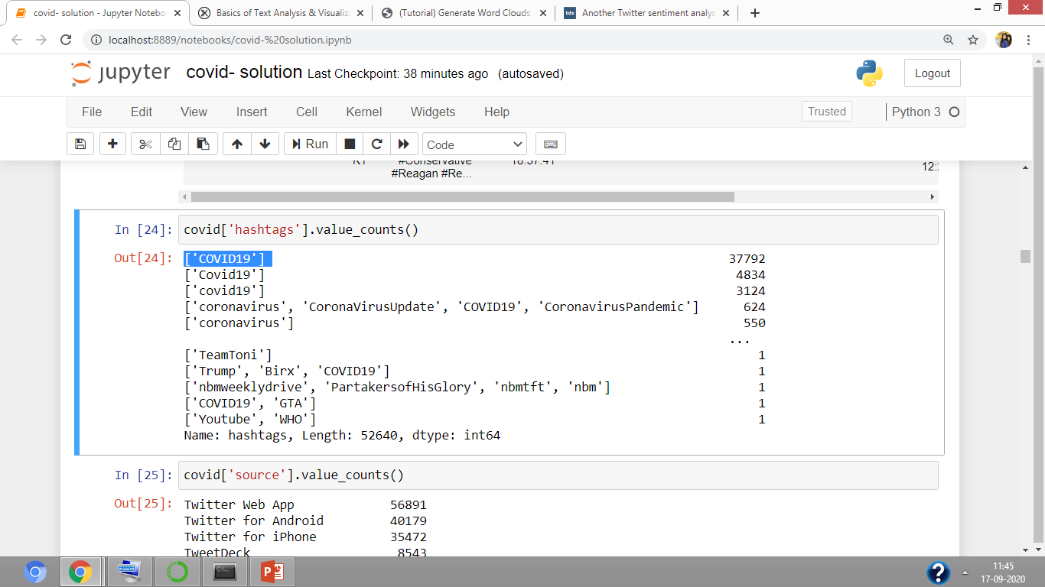
ANALYSIS ON HASTAG GARPH
From this hastag graph we can easily recognize that people have given different hastag. Most of the people have given ['COVID19'] .

Slide 5
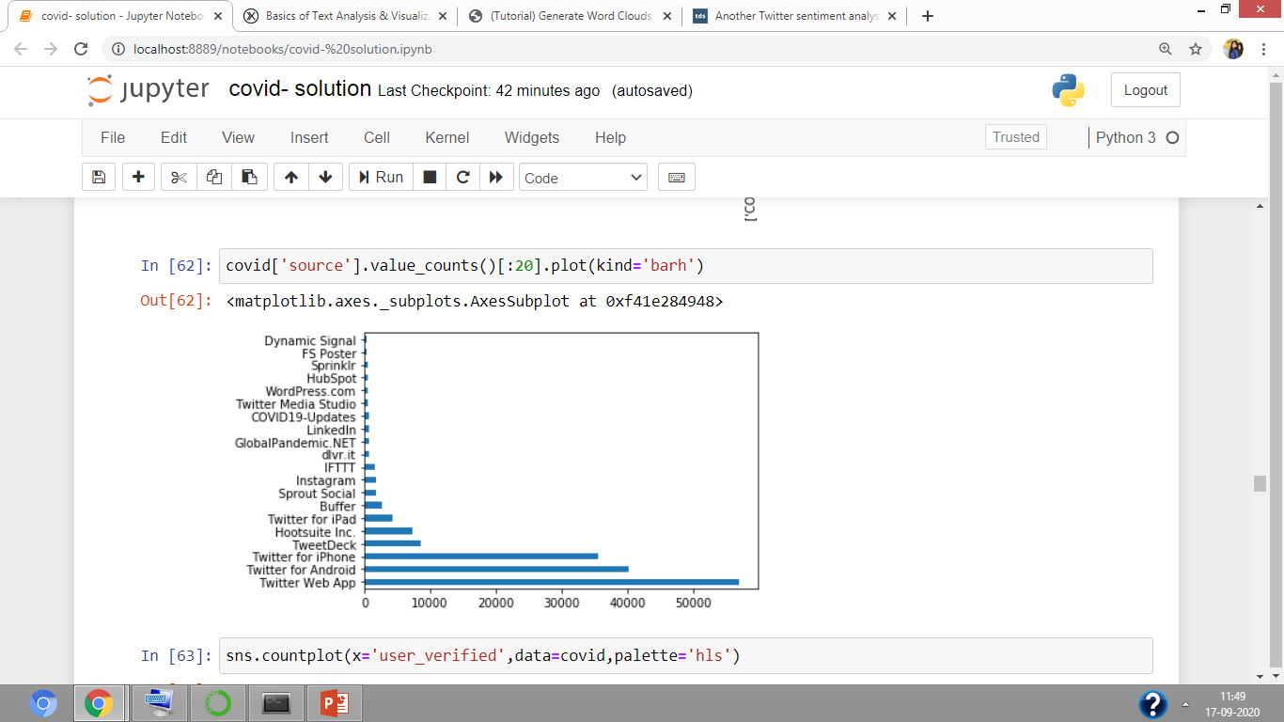
SOURCE GRAPH

Slide 6
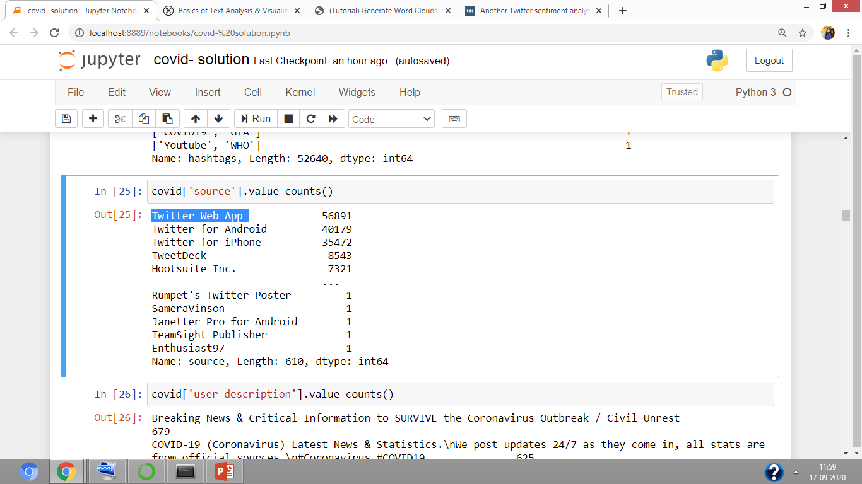
ANALYSIS ON SOURCE GRAPH
From this source graph we can easily recognize that most of the people have used Twitter Web App for tweet their views or condition.

Slide 7
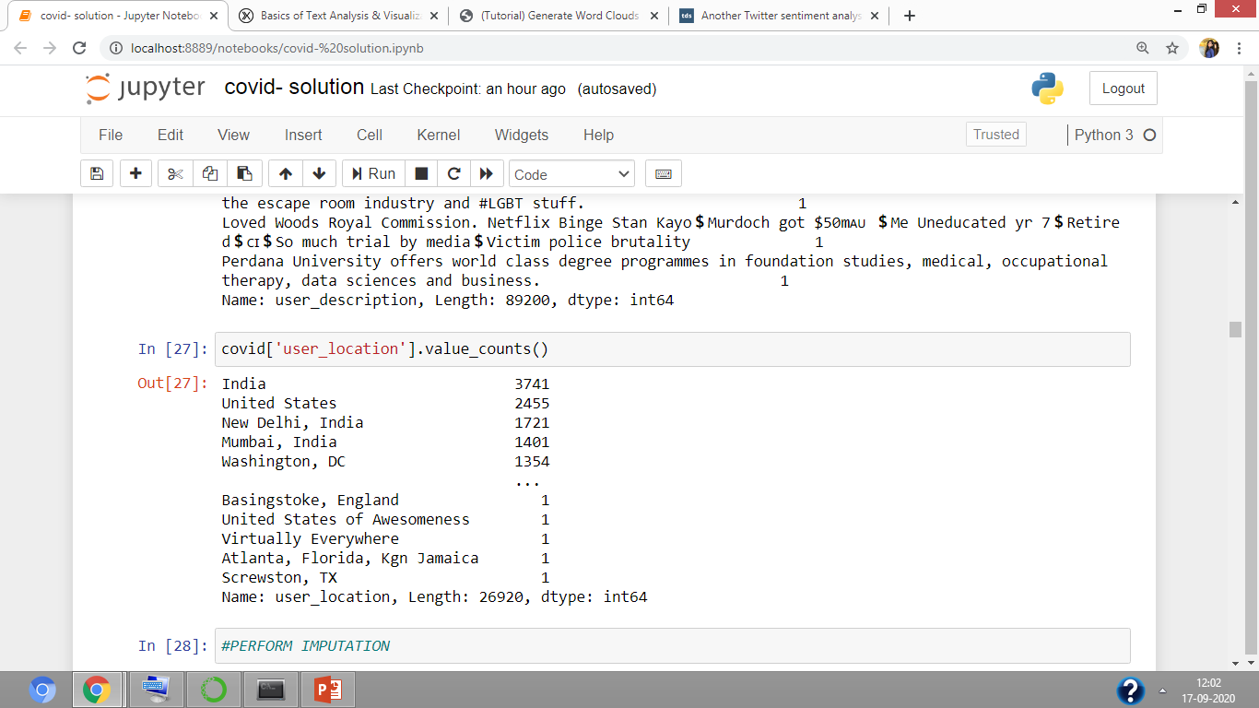
Country wise analysis: From this we can analyze that how many people tweeted from different location. We can also see that most of the people are from India

Slide 8
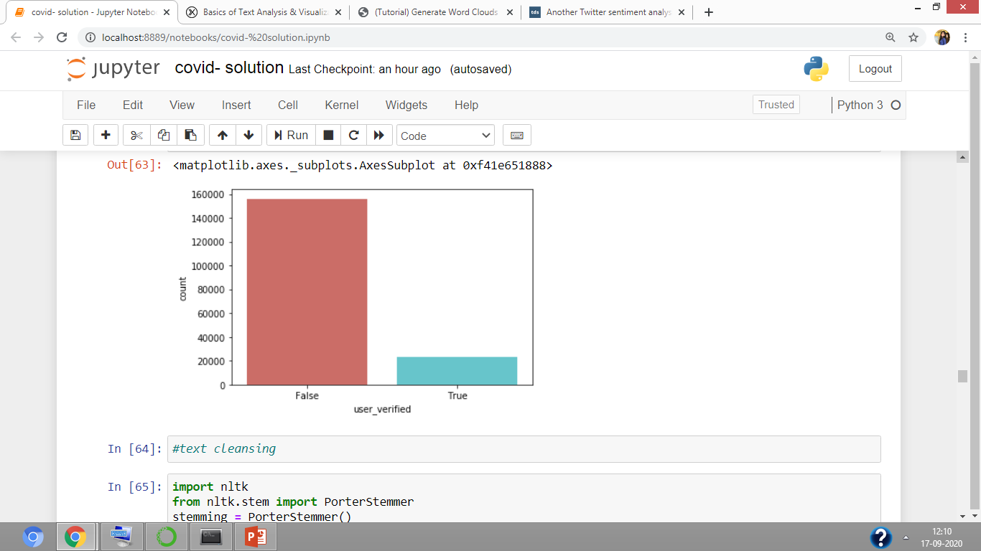
ANALYSIS BASED ON VARIFYING USER /PEOPLE

Slide 9
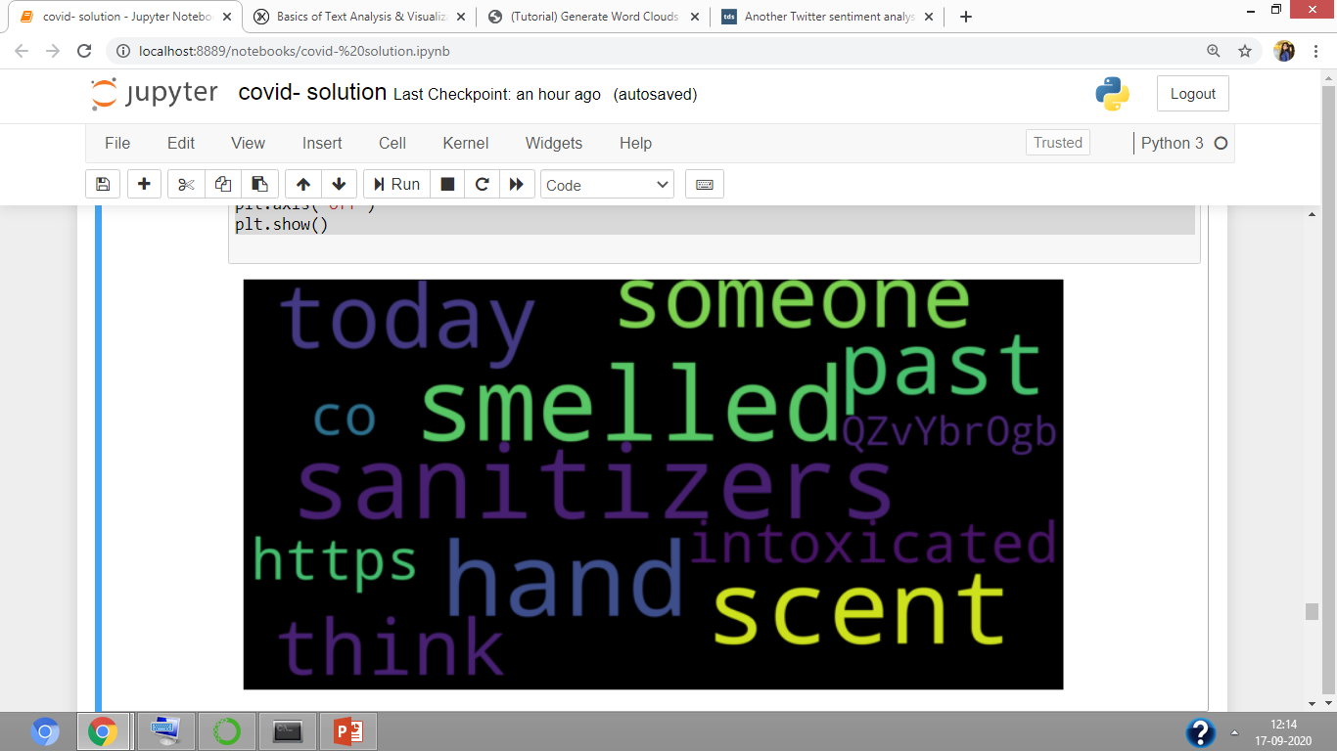
WORDCLOUD BASED ON PEOPLE TWEETS

Slide 10
ANLYSIS BASED ON WORDCLOUD
From this word cloud we can easily recognize that most of the people have used today, someone, hand, sanitizers, intoxicated, scent, think kind of words in their tweet. These are the most frequent words used in their tweets.
It describe the situation of people during covid19 and how to deal with this situation.
Through this word we can recognize that they are telling about the use of sanitizer helps to prevent from covid19.
People are also mentioned if someone don’t use sanitizer and don’t take proper prevention they will intoxicated.

Slide 11
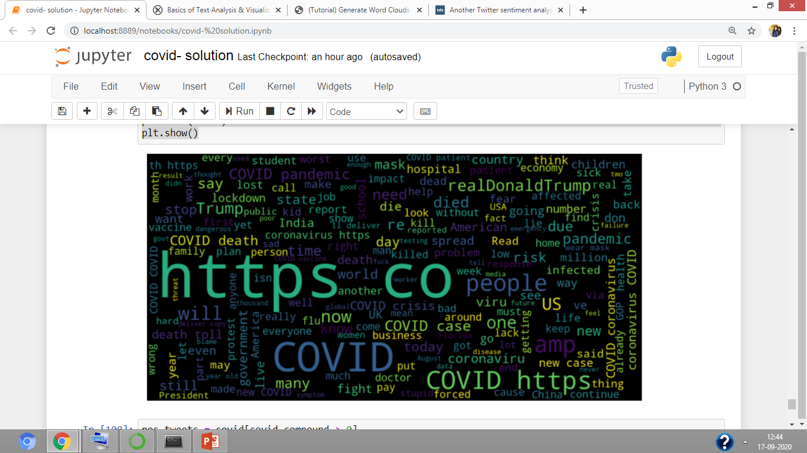
NEGATIVE WORDCLOUD GRAPH

Slide 12
Analysis based on negative word cloud
Through this word cloud we can easily analyze the negative impact of covid19 in this year 2020.
How lockdown impact the student studies.
How people lost their job due to this panademic situation.
Economic crises in different country.
Lot of people died in 2020.
Doctors are facing issues due to lack of medical facilities.

Slide 13
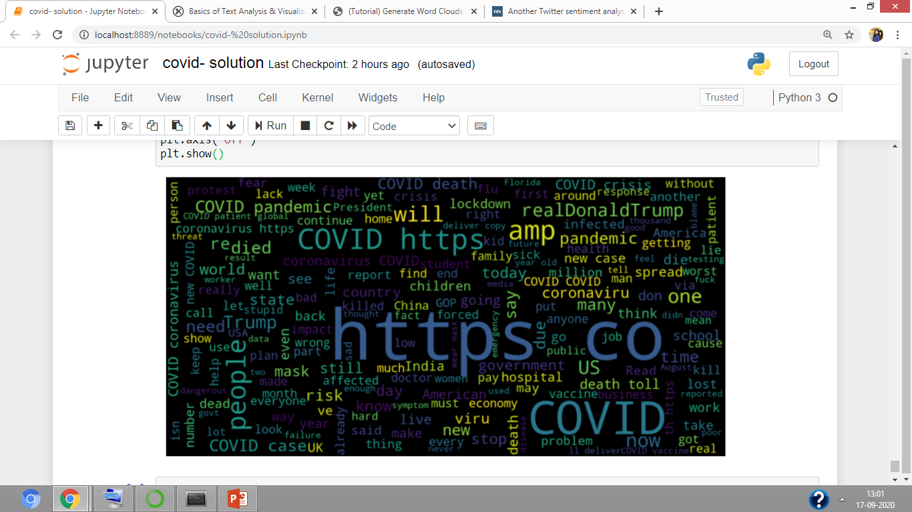
POSSITIVE WORDCLOUD GRAPH

Slide 14
ANALYSIS BASED ON WORD CLOUD
Through this we can analyze how different country take different steps to deal with this situation.
If people follow certain rules and take proper prevention we can handel the covid19 situation.

Slide 15
THANK YOU

